Slide 1



Goalkast
K
B
S
1962
Andrew Kim Shige Hashimoto Kaori Shiraishi Andre Elder Mathias Colleau

Slide 2
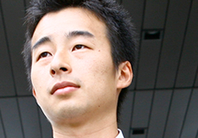
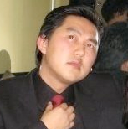
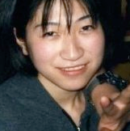
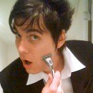
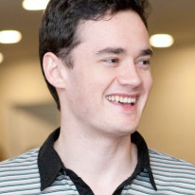
Chief Executive Officer Shige Hashimoto
Chief of Vision and Direction.
Chief Financial Officer Andrew Kim
Will lead finance related issues
Chief Operations Officer Kaori Shiraishi
Manages suppliers (contents producers) and updates contents
Chief Product Officer Andre Elder
Manage maintenance of Web-site and fix it when any trouble happens
Chief Marketing Officer Mathias Colleau
Analyze the market and conduct sales to acquire advertisers.
Goalkast

Slide 3


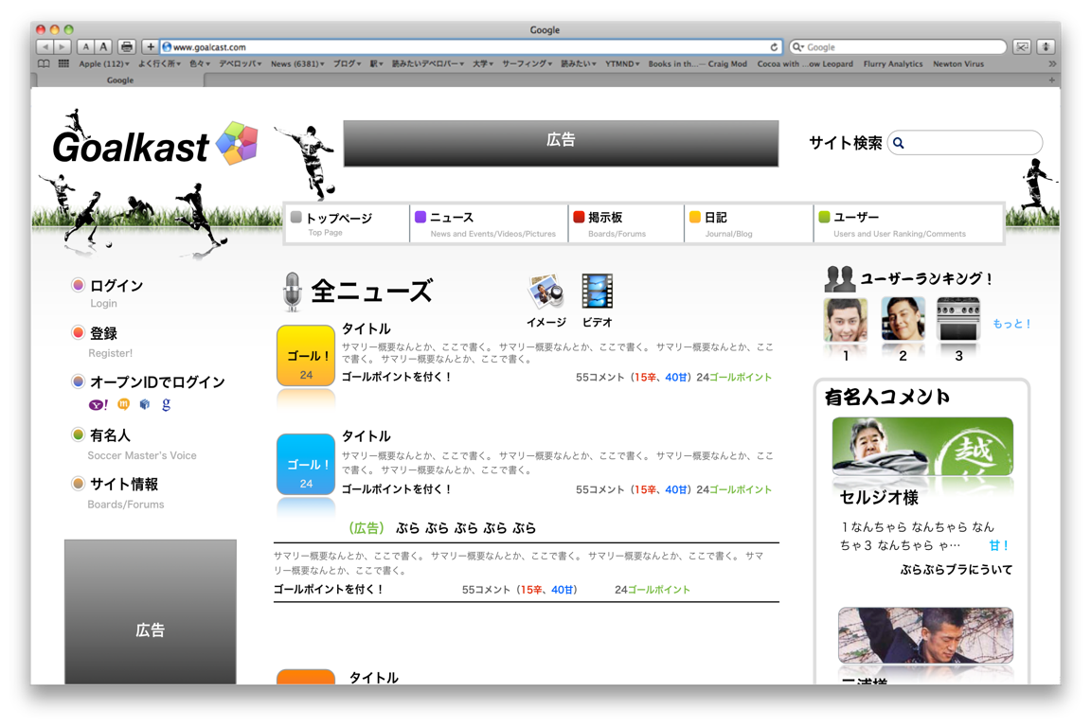
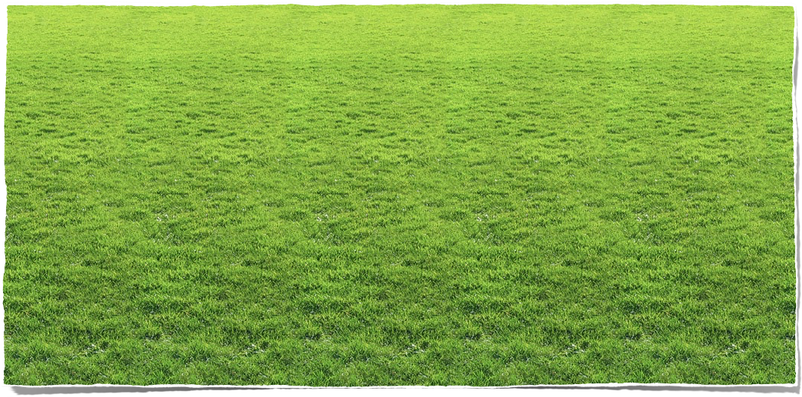
Summary: Business Plan
Company Name is Goalkast
We will provide a Soccer-Based Social Network Service
Place: Japan
Product: SNS
Price: Free
Corporation: Web Startup
Customer: Graduates 20-304 Years Old - Male
Competition: Weak

Slide 4
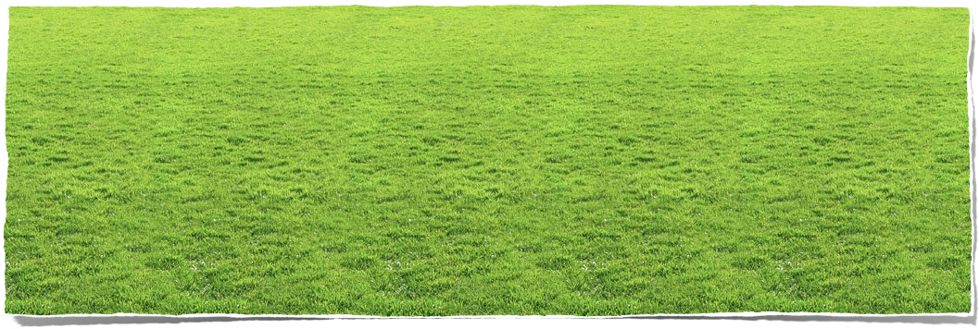
Summary: Our Vision
Provide Quality Soccer Contents to Japan, anytime, anywhere.
Motivate people interested in Soccer.
Provide an environment to interact with Soccer “Yumeijin”.
Notes:
We offer a high-quality soccer contents for the soccer fan in Japan anytime and anywhere.
The level of Japanese professional soccer still has the room to improve when we compare to that of other countries , so we believe that the opportunities to access the high quality soccer contents motivate people interested in soccer.

Slide 5
Market: Japan’s Soccer Population
High Propensity to Spend Cash
Familiarized with the Internet
Willing to Join a Community

Slide 6

Market: Size of Audience
Large Potential Audience
Internet Users |  | 2009 | 2010 | 2011 | 2012 | 2013 | 2014
Total Japan Internet Users (millions)* |  | 92.3 | 92.3 | 92.3 | 92.3 | 92.3 | 92.3
Japanese Population age 20 -34 |  | 18.6% | 18.6% | 18.6% | 18.6% | 18.6% | 18.6%
Population employed |  | 83.8% | 83.8% | 83.8% | 83.8% | 83.8% | 83.8%
Hardcore Football Fans |  | 2.5% | 2.5% | 2.6% | 2.8% | 2.9% | 3.1%
Fans interested in football in general |  | 12.6% | 12.6% | 13.2% | 13.9% | 14.5% | 15.3%
Targeted Internet users (thousands) |  | 1,804.7 | 1,804.7 | 1,895.0 | 1,989.7 | 2,089.2 | 2,193.7
Most Likely Scenario |  | 2009 | 2010 | 2011 | 2012 | 2013 | 2014
Desired market share |  |  | 15% | 30% | 45% | 50% | 50%
Unique visitor each year |  |  | 270.71 | 568.49 | 895.38 | 1,044.61 | 1,096.84
Unique visitor per month |  |  | 22.56 | 47.37 | 74.61 | 87.05 | 91.40
Notes:
There is a sizable target audience that Goalkast plans to address

Slide 7
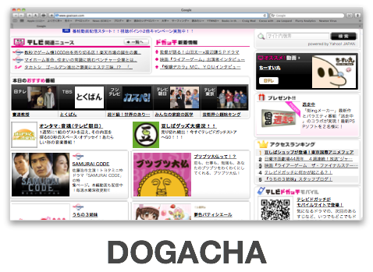
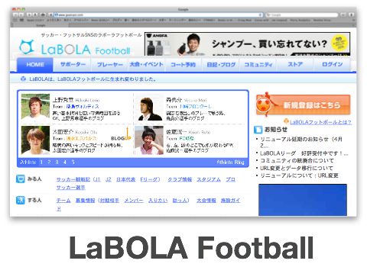
Market: Competitors
Navigation is complex
Visually unattractive
No substantial video content
As a result, both sites are not attractive for our core users.
Notes:
As a result, both sites are not attractive for our core users.

Slide 8

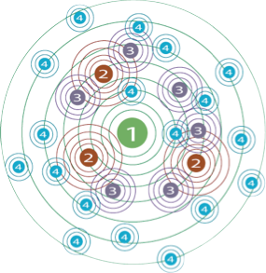















Marketing Strategy: Inexpensive is the Key
Word of Mouth: Nurturing Community
Cheap
Creates Trust
Research Customer Feedback Opportunity
Measurable & Trackable
Street Marketing: Distributing Flyers
It is cheap
Can be efficient if well planned
Notes:
Need to develop an inexpensive marketing strategy that generate conversations about our service.
Nurturing community, using influencers, sharing content in and between social networks.

Slide 9


Business Timeline
First Stage
User Generated Contents
Up-to-date news on Leagues
Columns written by semi-professional writers
Second Stage
Leverage the size of the user and community to attract major brand advertisers for sponsorships
Final Stage
Create business development opportunities with European soccer content providers
Notes:
WEBSITE
Create interesting content
Keep renewing
Permanent presence
Be recognizable (design)
SOCIAL MEDIA
Show who is behind the website
Nurture our community
Interact with the users
Be helpful and be everywhere
Monitor the feedback
Create referring tools
Focus on other SNS (mixi, FB, etc.)
SEARCH
Get indexed
Search Engine Optimization
OUTSIDE THE WEBSITE
Get help from third parties (Shige’s network)
Distribute flyers in relevant places (ex: soccer match)
Use of fun ad & emails to generate conversation

Slide 10


Marketing Strategy: Marketing Mix
Get Help from Shige’s Network
Distribute Flyers.
Use of Fun Ad & E-Mails
Get indexed
Search Engine Optimization
Notes:
WEBSITE
Create interesting content
Keep renewing
Permanent presence
Be recognizable (design)
SOCIAL MEDIA
Show who is behind the website
Nurture our community
Interact with the users
Be helpful and be everywhere
Monitor the feedback
Create referring tools
Focus on other SNS (mixi, FB, etc.)
SEARCH
Get indexed
Search Engine Optimization
OUTSIDE THE WEBSITE
Get help from third parties (Shige’s network)
Distribute flyers in relevant places (ex: soccer match)
Use of fun ad & emails to generate conversation

Slide 11
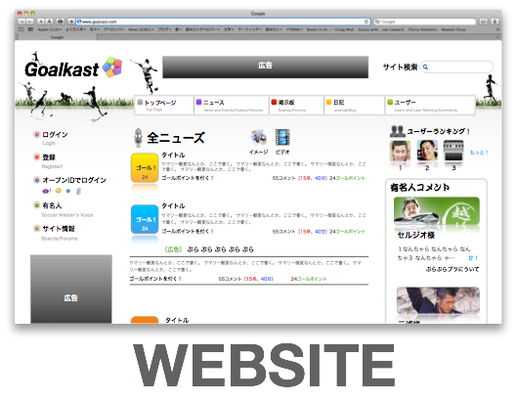
Marketing Strategy: Marketing Mix
Create interesting content
Keep renewing
Permanent presence
Be recognizable (design)
Get indexed
Search Engine Optimization
Notes:
WEBSITE
Create interesting content
Keep renewing
Permanent presence
Be recognizable (design)
SOCIAL MEDIA
Show who is behind the website
Nurture our community
Interact with the users
Be helpful and be everywhere
Monitor the feedback
Create referring tools
Focus on other SNS (mixi, FB, etc.)
SEARCH
Get indexed
Search Engine Optimization
OUTSIDE THE WEBSITE
Get help from third parties (Shige’s network)
Distribute flyers in relevant places (ex: soccer match)
Use of fun ad & emails to generate conversation

Slide 12

Marketing Strategy: Marketing Mix
Show who is behind the website
Nurture our community
Interact with the users
Be helpful and be everywhere
Monitor the feedback
Create referring tools
Focus on other SNS (mixi, etc)
Create interesting content
Keep renewing
Permanent presence
Be recognizable (design)
Notes:
WEBSITE
Create interesting content
Keep renewing
Permanent presence
Be recognizable (design)
SOCIAL MEDIA
Show who is behind the website
Nurture our community
Interact with the users
Be helpful and be everywhere
Monitor the feedback
Create referring tools
Focus on other SNS (mixi, FB, etc.)
SEARCH
Get indexed
Search Engine Optimization
OUTSIDE THE WEBSITE
Get help from third parties (Shige’s network)
Distribute flyers in relevant places (ex: soccer match)
Use of fun ad & emails to generate conversation

Slide 13
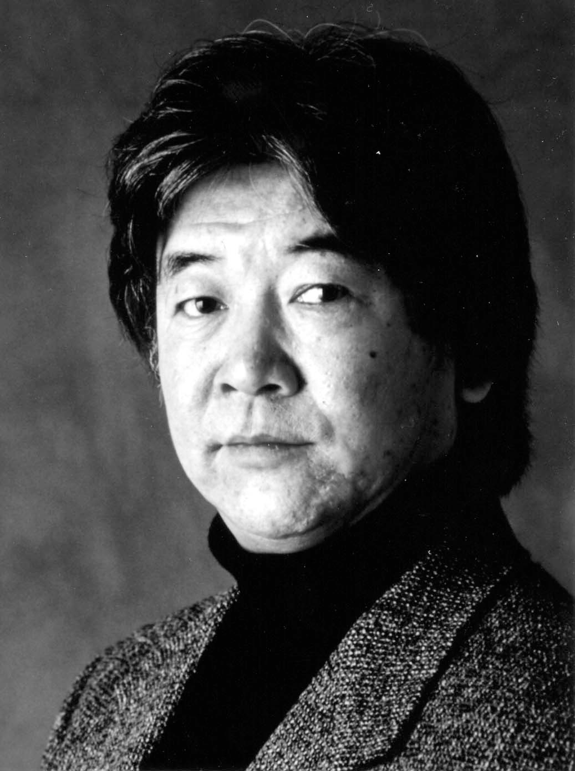
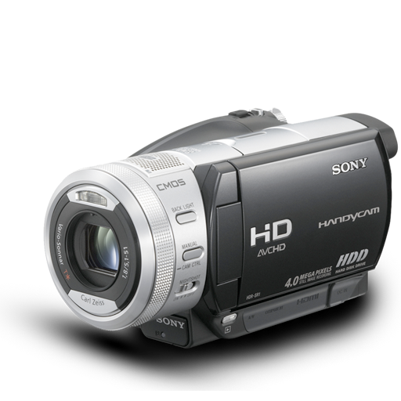

Product Outline: Content
“Community Provider”
“Community”
Site Generated Content
News
Exclusive Information
Yumeijin (有名人)
User Generated Content
News
User Provided Information
Bulletin Boards/Images/Videos etc
Notes:
WEBSITE
Create interesting content
Keep renewing
Permanent presence
Be recognizable (design)
SOCIAL MEDIA
Show who is behind the website
Nurture our community
Interact with the users
Be helpful and be everywhere
Monitor the feedback
Create referring tools
Focus on other SNS (mixi, FB, etc.)
SEARCH
Get indexed
Search Engine Optimization
OUTSIDE THE WEBSITE
Get help from third parties (Shige’s network)
Distribute flyers in relevant places (ex: soccer match)
Use of fun ad & emails to generate conversation

Slide 14
Product Outline: Demo
DEMO
Notes:
WEBSITE
Create interesting content
Keep renewing
Permanent presence
Be recognizable (design)
SOCIAL MEDIA
Show who is behind the website
Nurture our community
Interact with the users
Be helpful and be everywhere
Monitor the feedback
Create referring tools
Focus on other SNS (mixi, FB, etc.)
SEARCH
Get indexed
Search Engine Optimization
OUTSIDE THE WEBSITE
Get help from third parties (Shige’s network)
Distribute flyers in relevant places (ex: soccer match)
Use of fun ad & emails to generate conversation

Slide 15
Business Timeline
First Stage
User Generated Contents
Up-to-date news on Leagues
Columns written by semi-professional writers
Second Stage
Leverage the size of the user and community to attract major brand advertisers for sponsorships
Final Stage
Create business development opportunities with European soccer content providers
WC
World Cup
Notes:
WEBSITE
Create interesting content
Keep renewing
Permanent presence
Be recognizable (design)
SOCIAL MEDIA
Show who is behind the website
Nurture our community
Interact with the users
Be helpful and be everywhere
Monitor the feedback
Create referring tools
Focus on other SNS (mixi, FB, etc.)
SEARCH
Get indexed
Search Engine Optimization
OUTSIDE THE WEBSITE
Get help from third parties (Shige’s network)
Distribute flyers in relevant places (ex: soccer match)
Use of fun ad & emails to generate conversation

Slide 16


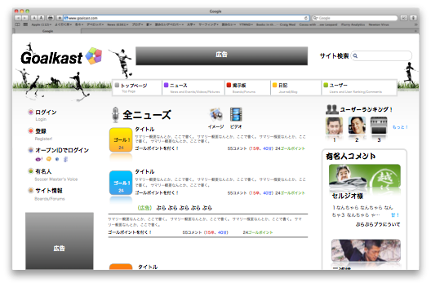


Operation Plan: Operation Environment
Customer
Web-site Hosting
Provide Web-site
Provide place to share news and comments, and video contents
Submit news and comments
Write
Contents, feeding video on demand
Provide place to advertise
Content Providers
Advertisers
Notes:
WEBSITE
Create interesting content
Keep renewing
Permanent presence
Be recognizable (design)
SOCIAL MEDIA
Show who is behind the website
Nurture our community
Interact with the users
Be helpful and be everywhere
Monitor the feedback
Create referring tools
Focus on other SNS (mixi, FB, etc.)
SEARCH
Get indexed
Search Engine Optimization
OUTSIDE THE WEBSITE
Get help from third parties (Shige’s network)
Distribute flyers in relevant places (ex: soccer match)
Use of fun ad & emails to generate conversation

Slide 17
Financial Plan: Scenario / Profit Forecast
Initial Payoff
Operating Profit Turns Positive
Break Even
Notes:
Initial Pay-off will happen in 27 months

Slide 18
Financial Plan: Scenario / Profit Forecast
Goalkast Will be Operationally Profitable by 2012
Planned Scenario |  | 2010 (9 months) | 2011 | 2012 | 2013
Total Japan Internet Users (millions)* |  | 92.3 | 92.3 | 92.3 | 92.3
Operating Profit |  | -¥2,012,895.62 | -¥63,852.67 | ¥9,776,376.93 | ¥22,723,430.83
Accumulated Profit |  | -¥2,012,895.62 | -¥2,076,748.28 | ¥7,699,628.64 | ¥30,423,059.48
Alternate Scenario |  | 2010 (9 months) | 2011 | 2012 | 2013
Operating Profit |  | -¥2,012,895.62 | -¥1,349,525.50 | ¥6,295,621.54 | ¥14,973,533.94
Accumulated Profit |  | -¥2,012,895.62 | -¥3,362,421.12 | ¥2,933,200.41 | ¥17,906,734.35
Notes:
Revenue from both advertising and paid content services will help offset initial set-up and operation cost.

Slide 19
Financial Plan: Scenario / Profit Forecast
Profitable by 2012 Even without Paid Contents
Notes:
Even without securing paid game contents, business will be profitable by 2012

Slide 20
Financial Plan: Scenario / Profit Forecast
Key Assumptions
Cost Assumptions
Description |  | Type | Frequency (one time/recurring) | Unit cost (Yen) | Number of Units | Total Cost | Notes
Domain name purchase |  | Initial Cost | One time | 1,000 | 1 | 1,000
Web Hosting Cost |  | SG&A - Web maintenance | Monthly | 5000 |  |  | "Cost will increase with more usage, each unit is 20GB of memory"
Search Advertising Activation |  | SG&A - Marketing | One time | 500 | 1 | 500
Search Advertising monthly |  | SG&A - Marketing | Monthly | 7 | 1000 | 7,000 | Units (keywords), CPC is 3-7 yen per click
Word of Mouth Marketing |  | SG&A - Marketing
Online Display Banner Advertising |  | SG&A - Marketing | per thousand impressions | 500
Other marketing cost |  | SG&A - Marketing
Part-time Marketing Hire |  | SG&A - Marketing | hourly | 1300 | 1
Web Developer/ Designer partime |  | SG&A - Salary | Hourly | 4000
Article cost |  | SG&A - operations | per writer per month | 10000
Pageview per unique visitors |  | 3
Revenue per pageview (yen per thousand impressions) |  | 500
Paid content user share |  | 1%
Average paid service share per month |  | 5000 | Assume watching 2 full games (currently UEFA charges $2 per game online)
Cost of Video Content Acquisition |  | 70% of Revenue | Assume that payment is collected immediately and paid out immediately as well
Growth rate of paid users |  | 2-4%
CTR |  | 0.02%
Banner Ad price quote growth |  | 2-5%
Notes:
Key assumptions include expenses model and structure

Slide 21
Thank You

